Slide 1

Digital Design
With an Introduction to the Verilog HDL, VHDL, and SystemVerilog
6th Edition, Global Edition
Chapter 03
Gate-Level Minimization

Slide 2
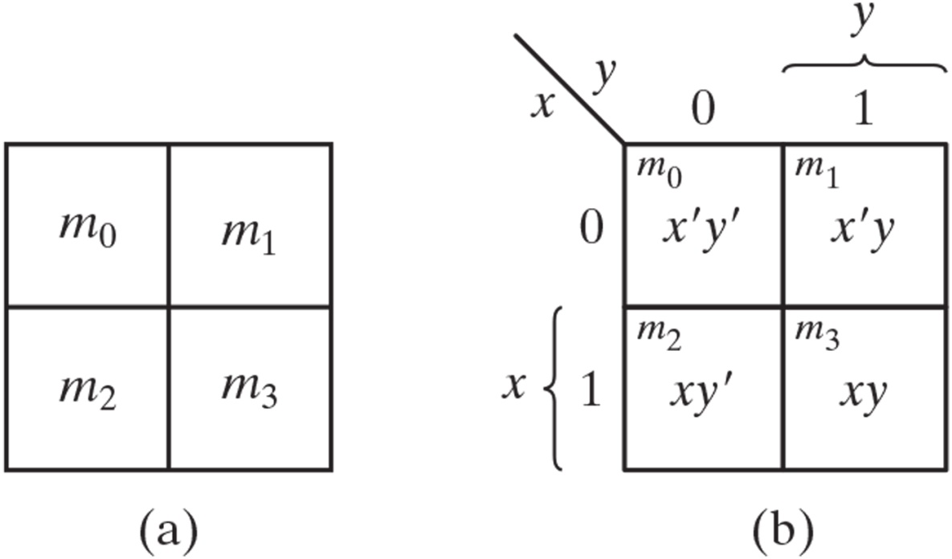
Two-variable K-map.

Slide 3
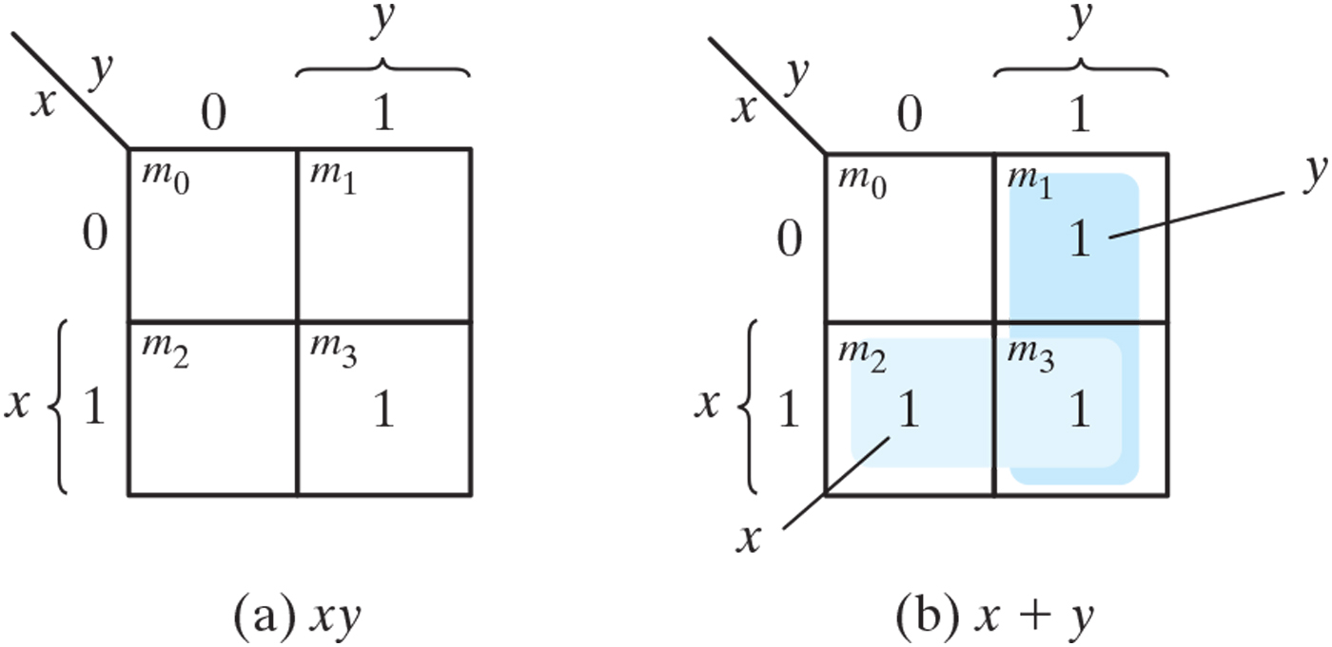
Representation of functions in the K-map.

Slide 4
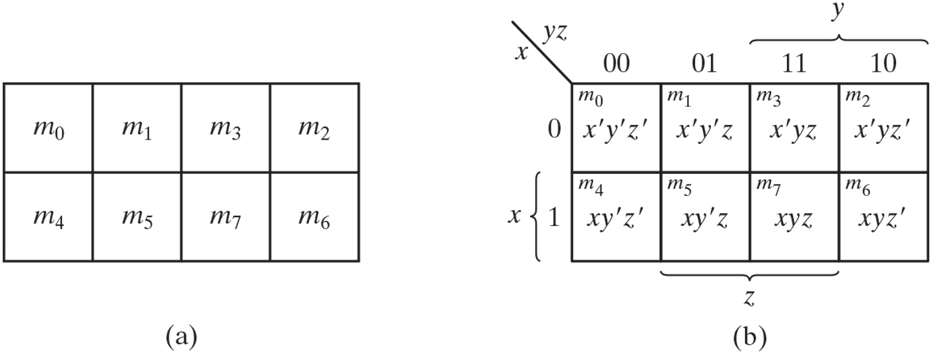
Three-variable K-map.

Slide 5
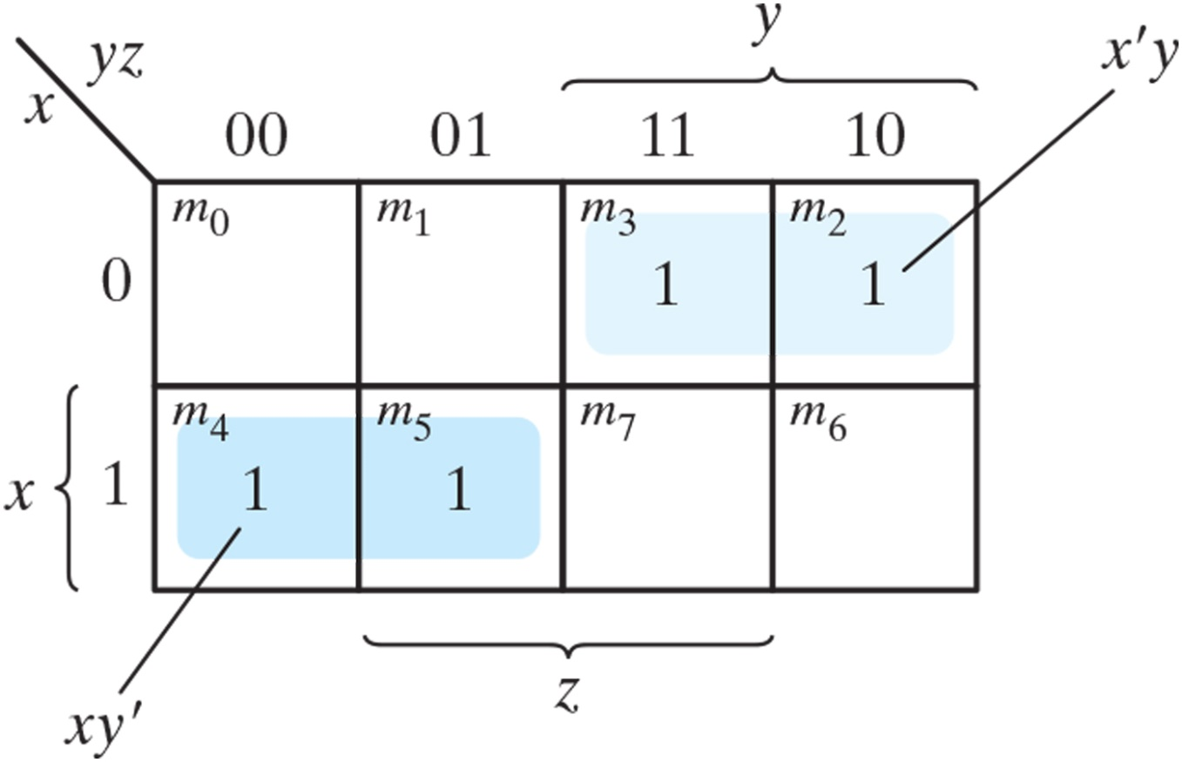
Map for Example 3.1, F(x, y, z) = 𝚺(2, 3, 4, 5) = x’y + xy’.

Slide 6
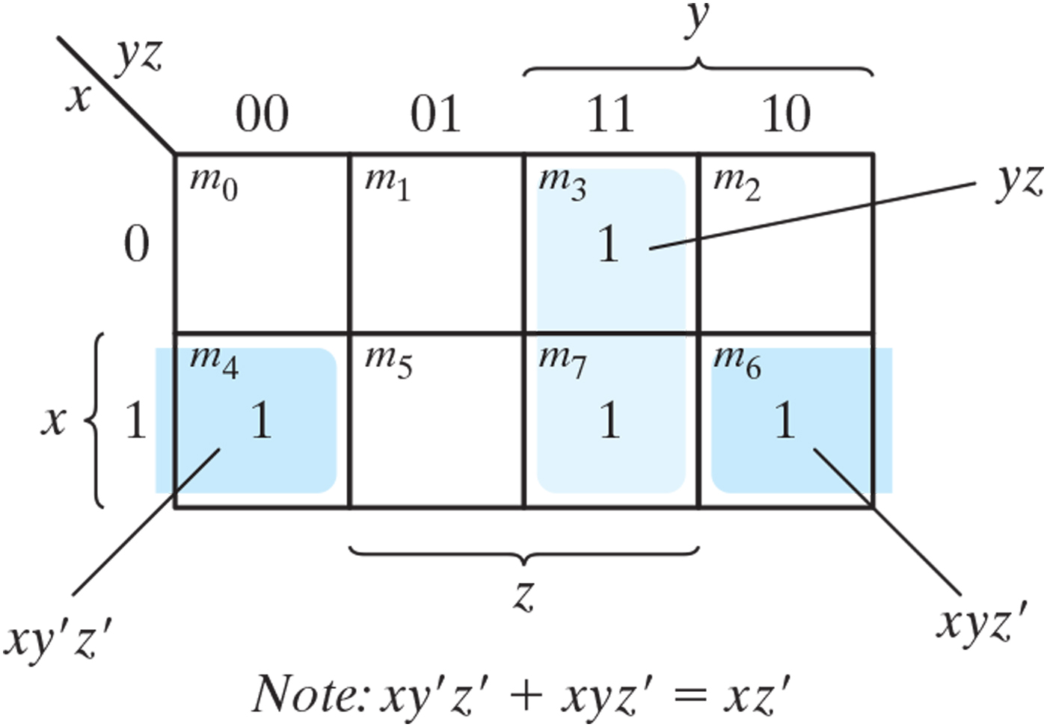
Map for Example 3.2, F(x, y, z) = 𝚺(3, 4, 6, 7) = yz + xz’.

Slide 7
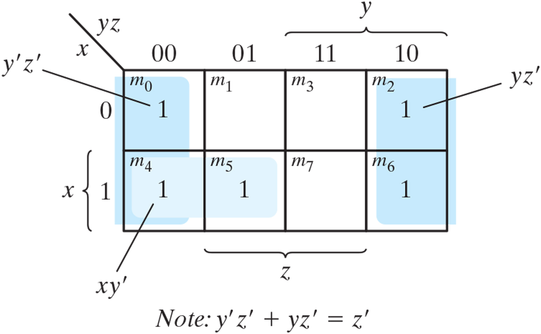
Map for Example 3.3, F(x, y, z) = 𝚺(0, 2, 4, 5, 6) = z’ + xy’.

Slide 8
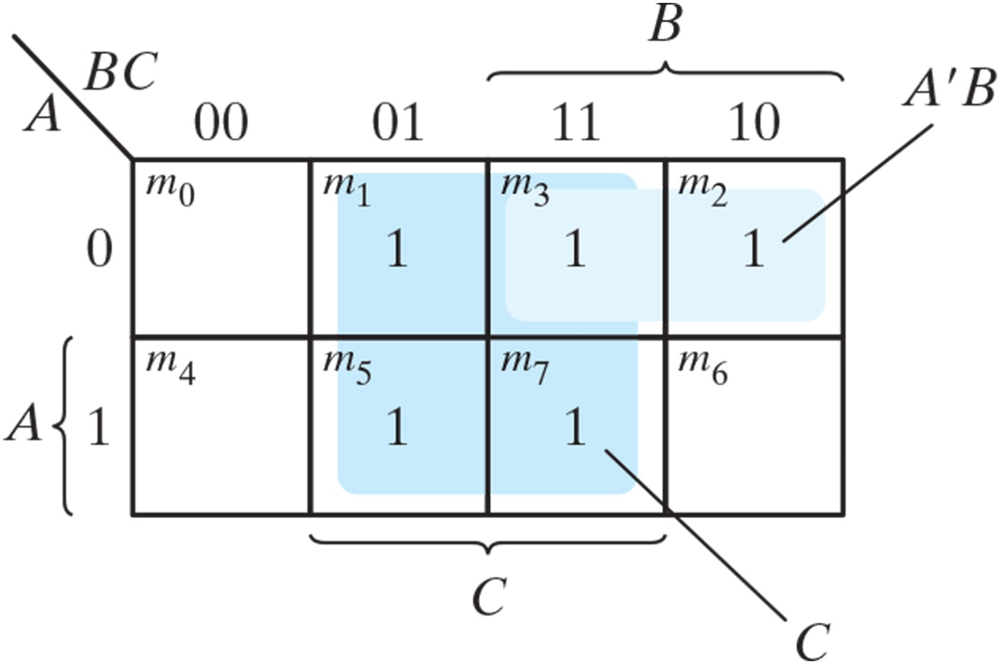
Map of Example 3.4, A’C + A’B + AB’C + BC = C + A’B.

Slide 9
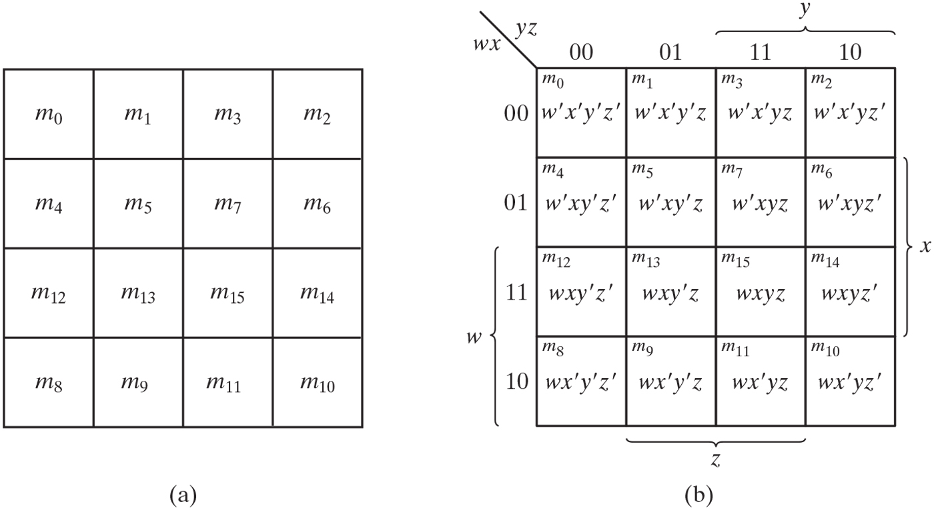
Four-variable map.

Slide 10
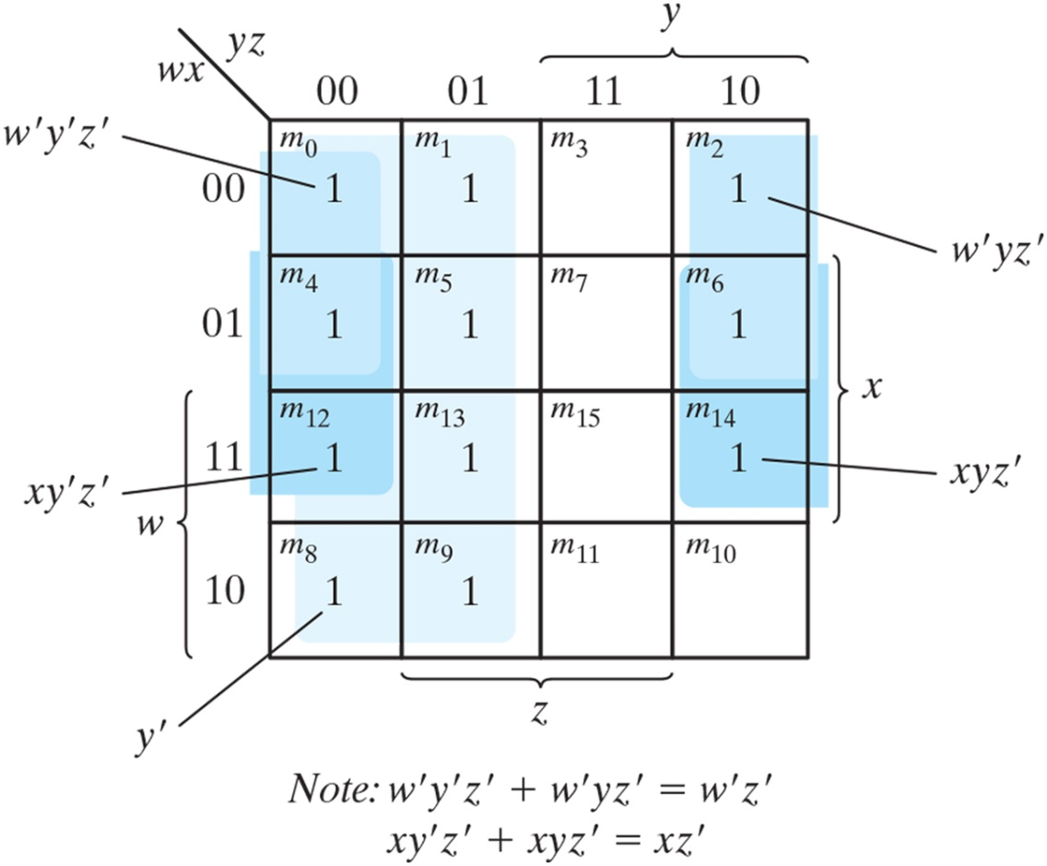
Map for Example 3.5, F(w, x, y, z) = 𝚺(0, 1, 2, 4, 5, 6, 8, 9, 12, 13, 14) = y’ + w’z’ + xz’.

Slide 11
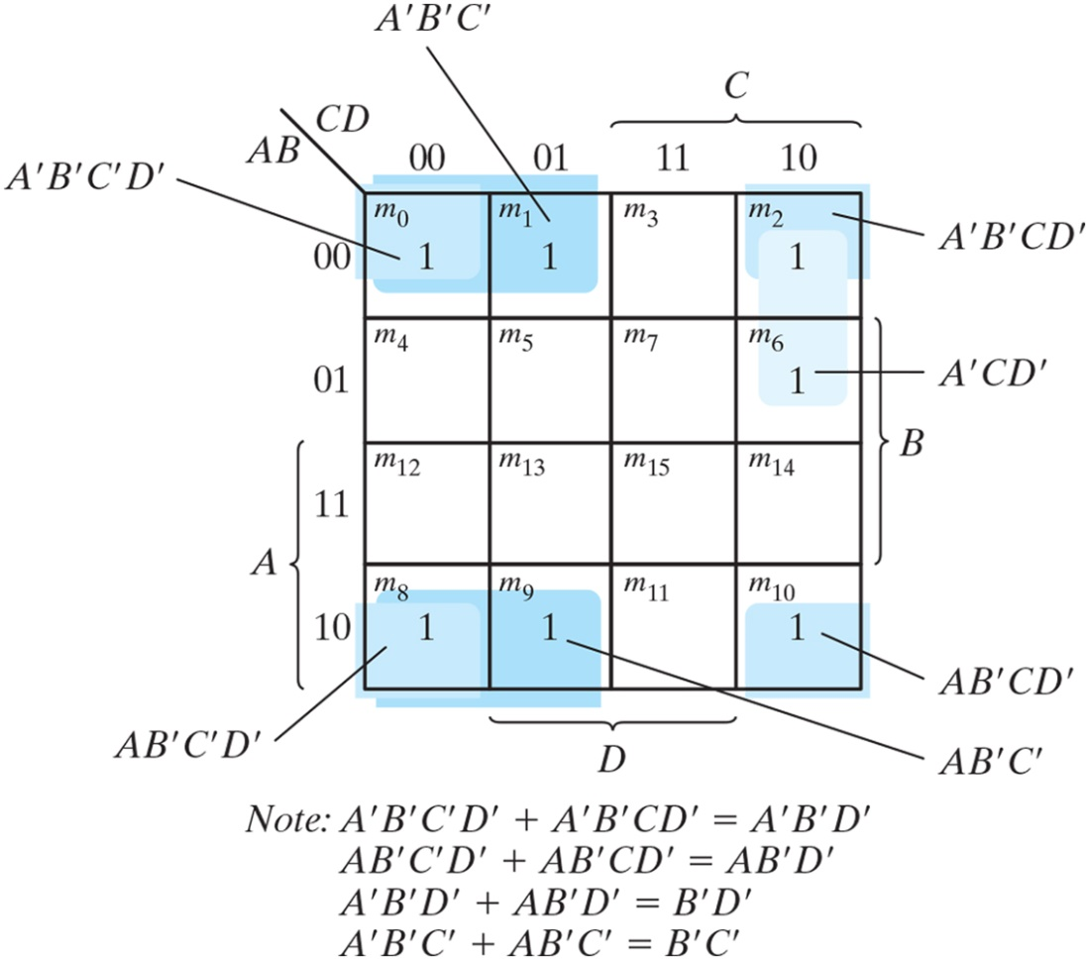
Map for Example 3.6, A’B’C’ + B’CD’ + A’BCD’ + AB’C = B’D’ + B’C’ + A’CD’.

Slide 12
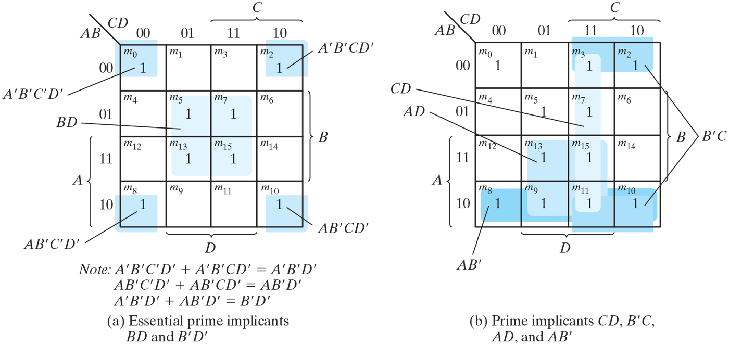
Simplification using prime implicants.

Slide 13
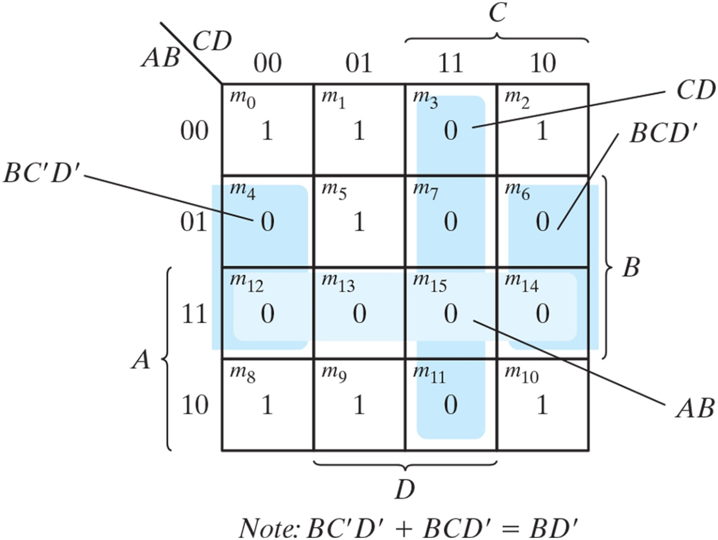
Map for Example 3.7, F(A, B, C, D) = 𝚺(0, 1, 2, 5, 8, 9, 10) = BD + BC + ACD = (A’ + B’)(C’ + D’)(B’ + D).

Slide 14
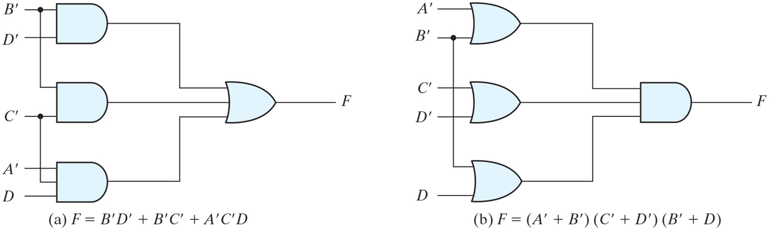
Gate implementations of the function of Example 3.7.

Slide 15
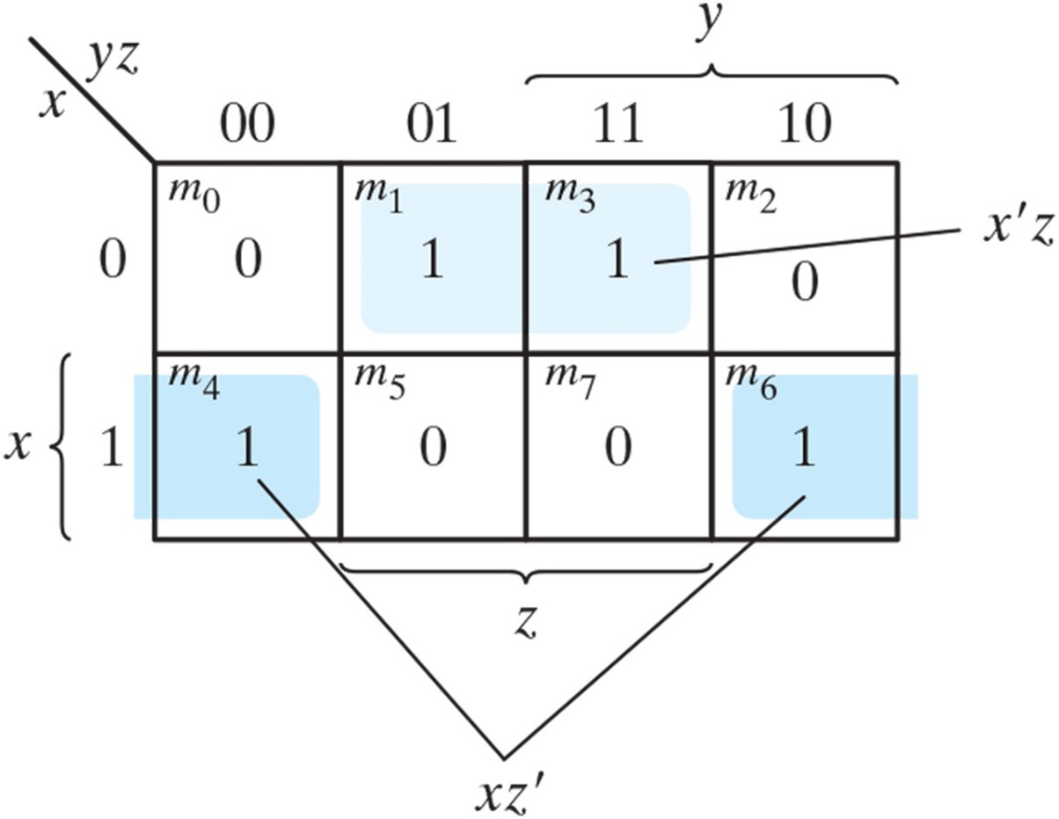
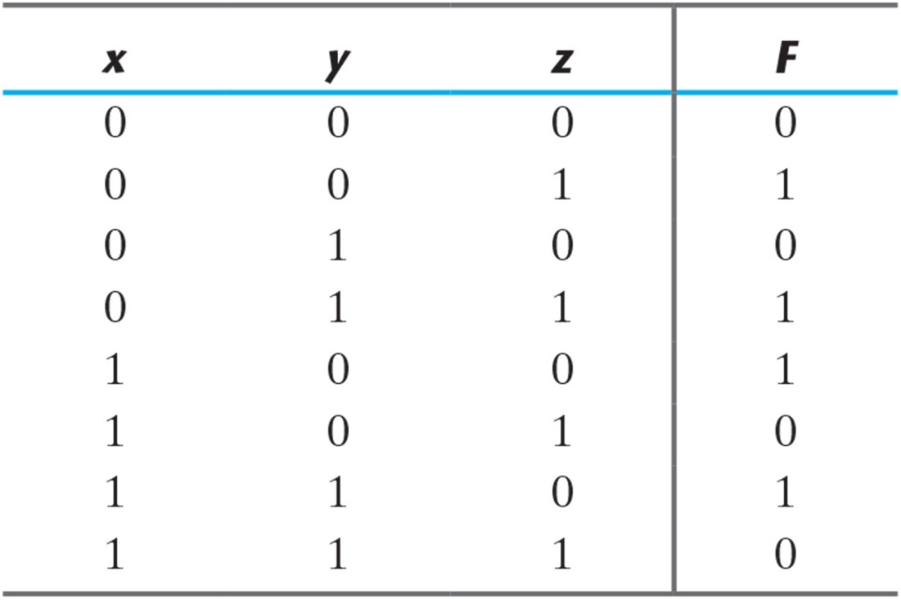
Map for the function of Table 3.1.

Slide 16
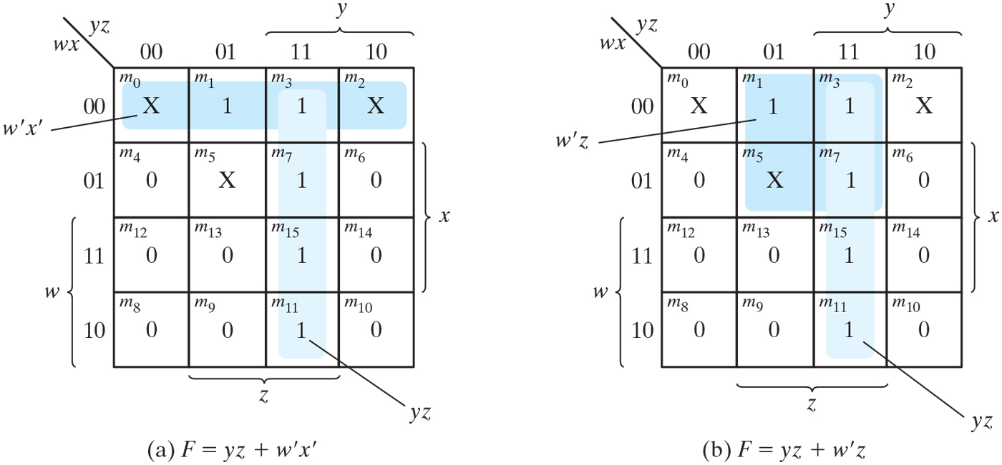
Example with don’t-care conditions.
Simplify the Boolean function, F(w, x, y, z) = Σ(1,3,7,11,15)
Don’t-care conditions, d(w, x, y, z) = Σ(0, 2, 5)

Slide 17
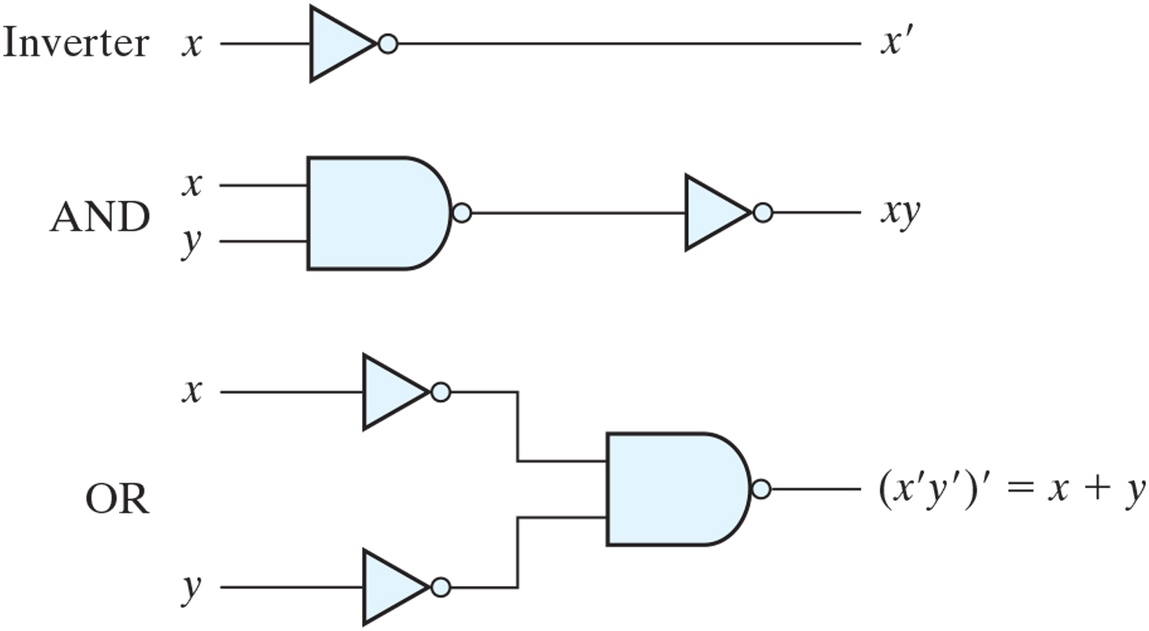
Logic operations with NAND gates.

Slide 18
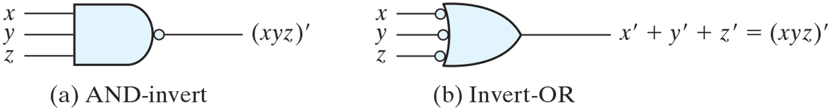
Two graphic symbols for a three-input NAND gate.

Slide 19
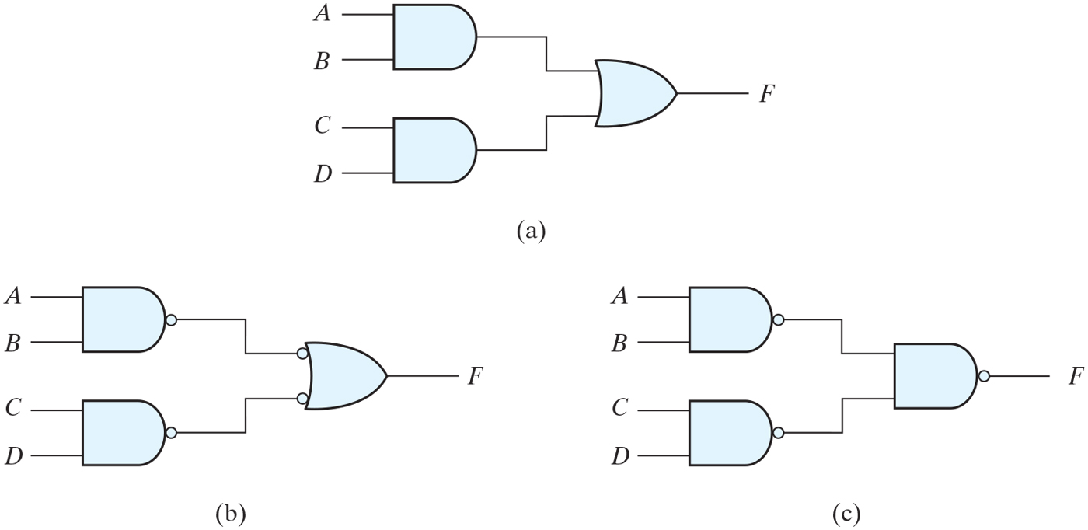
Three ways to implement F = AB + CD.

Slide 20
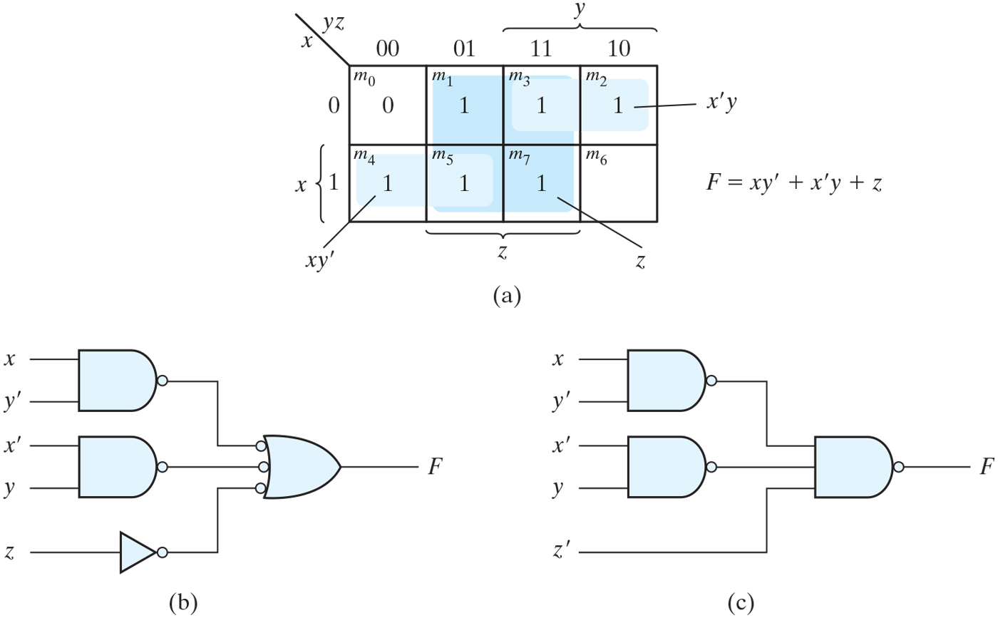
Solution to Example 3.9.

Slide 21
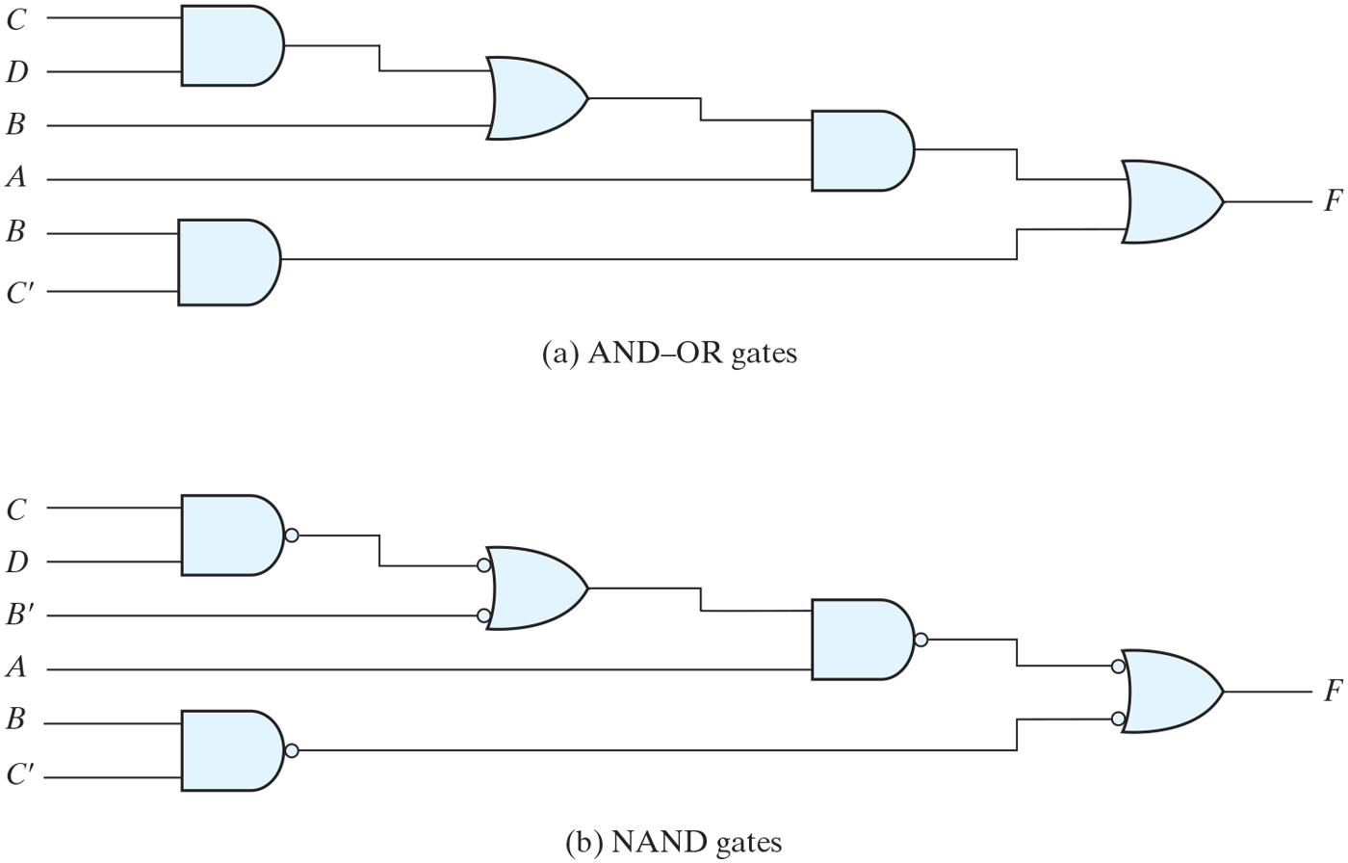
Implementing F = A(CD + B) + BC’.

Slide 22
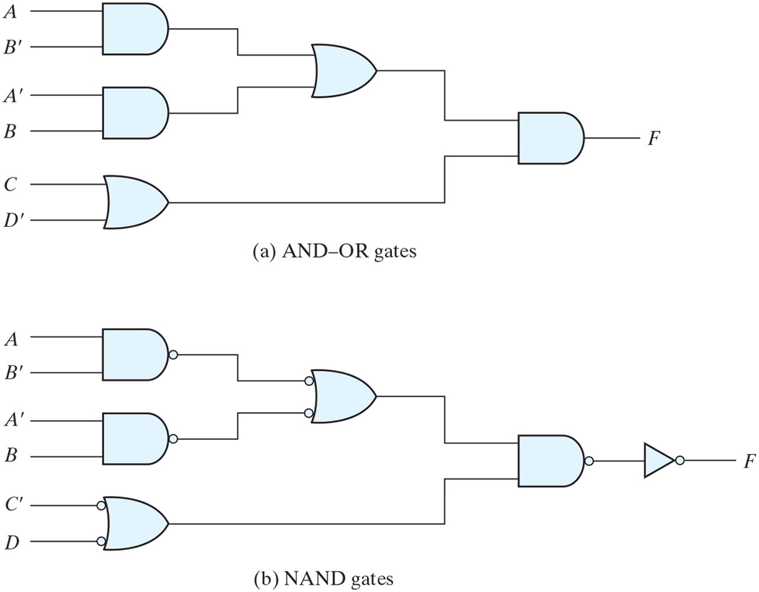
Implementing F = (AB’ + A’B)(C + D’).

Slide 23
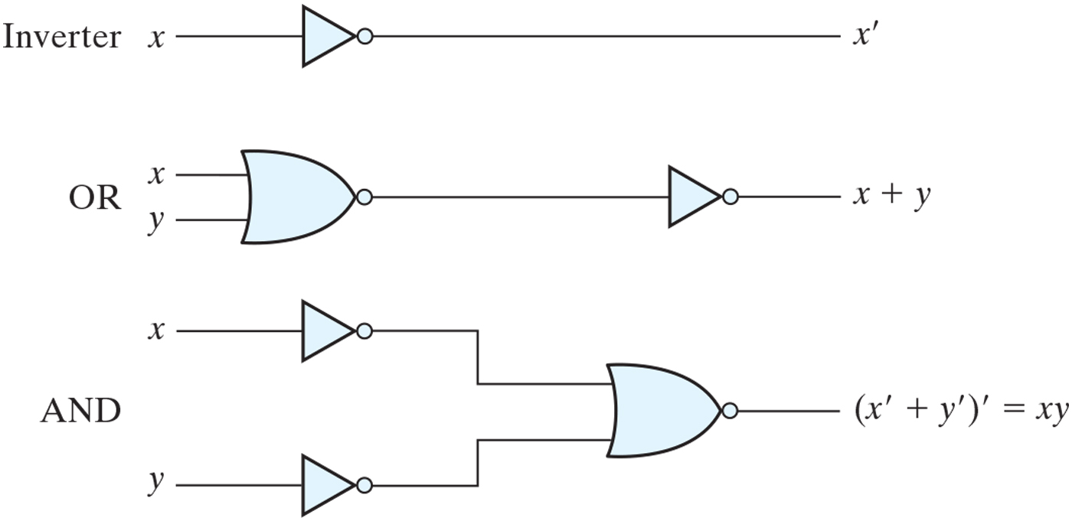
Logic operations with NOR gates.

Slide 24
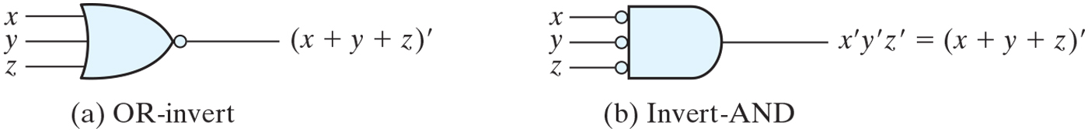
Two graphic symbols for the NOR gate.

Slide 25
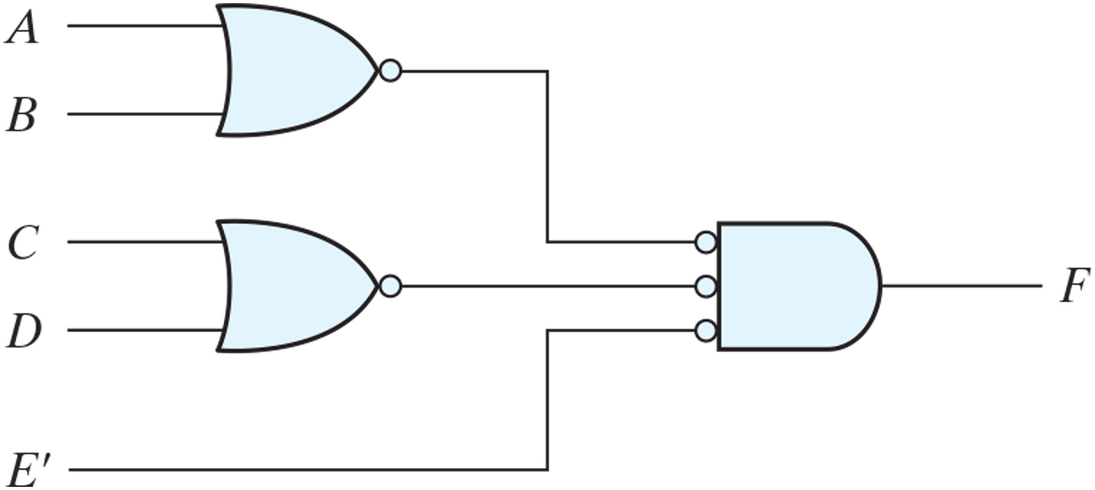
Implementing F = (A + B)(C + D)E.

Slide 26
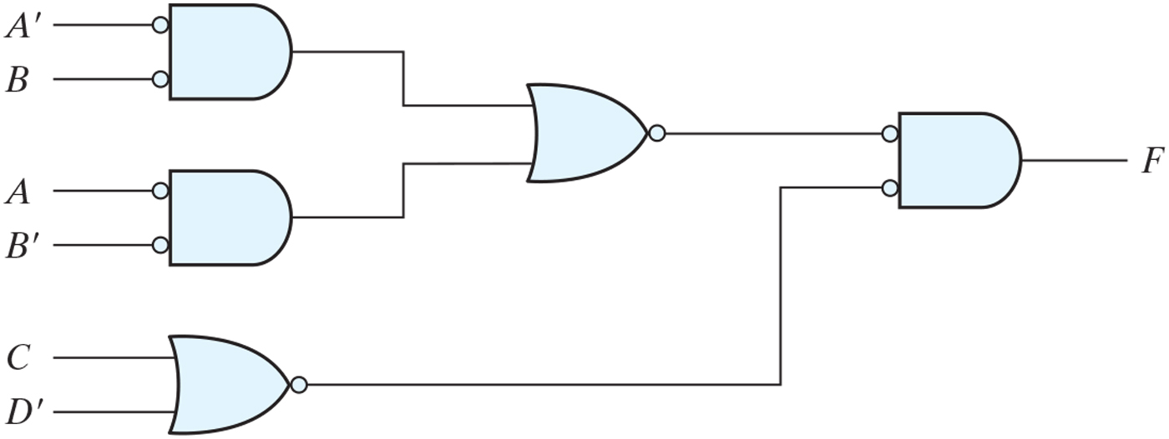
Implementing F = (AB’ + A’B)(C + D’) with NOR gates.

Slide 27
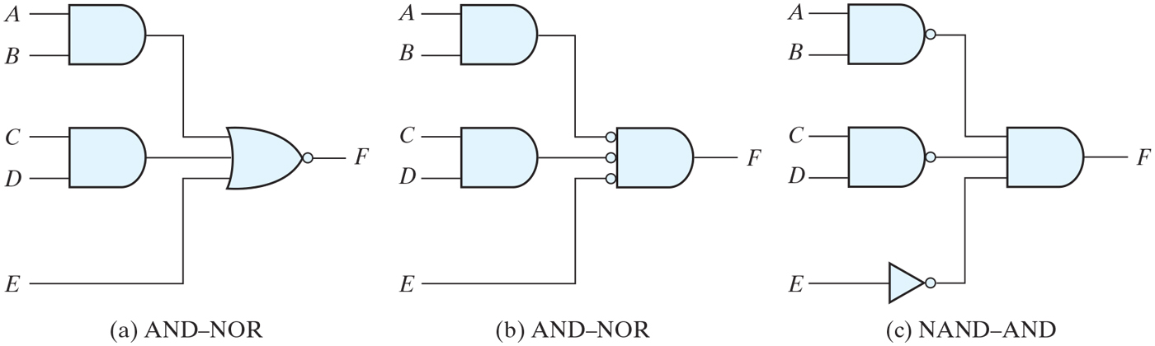
AND–OR–INVERT circuits, F = (AB + CD + E)’.

Slide 28
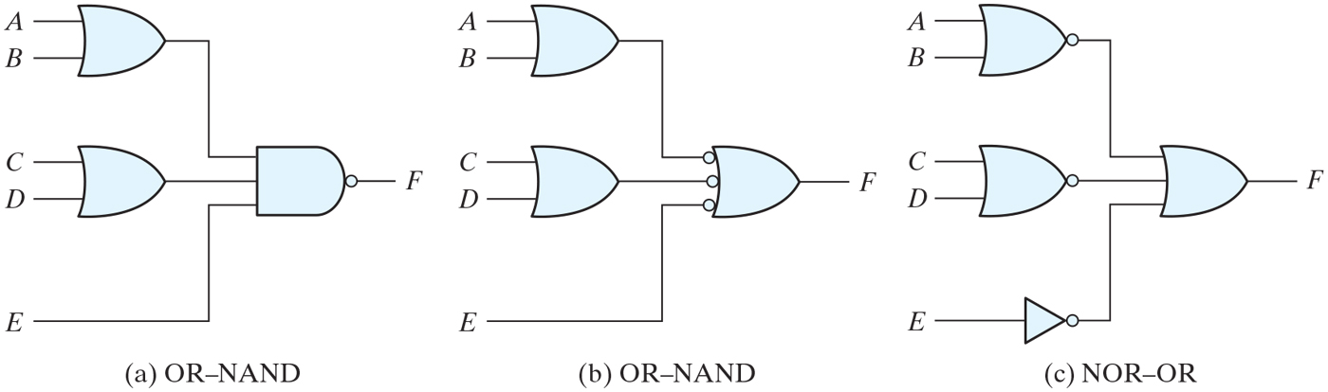
OR–AND–INVERT circuits, F = [(A + B)(C + D)E]’.

Slide 29
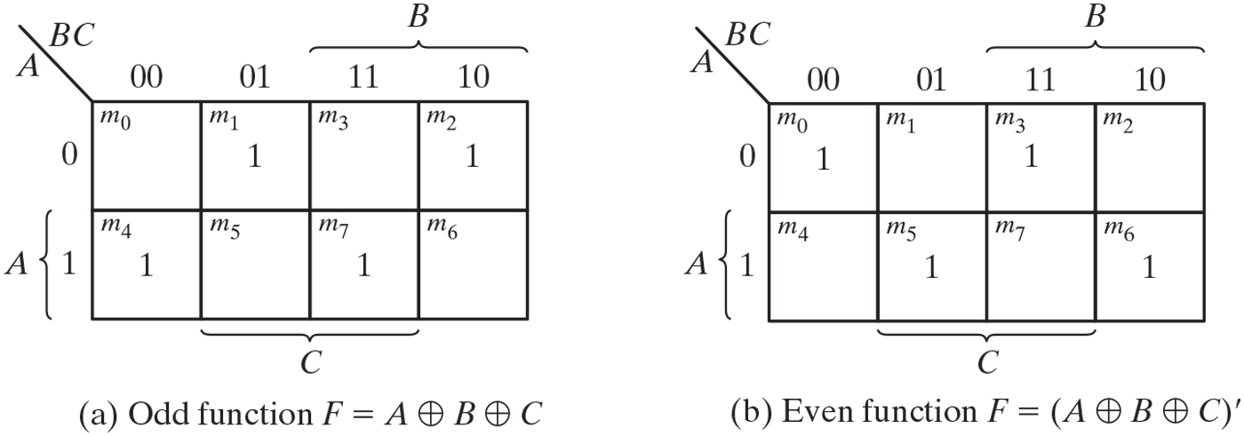
Map for a three-variable exclusive-OR function.
x y = xy' + x'y

Slide 30
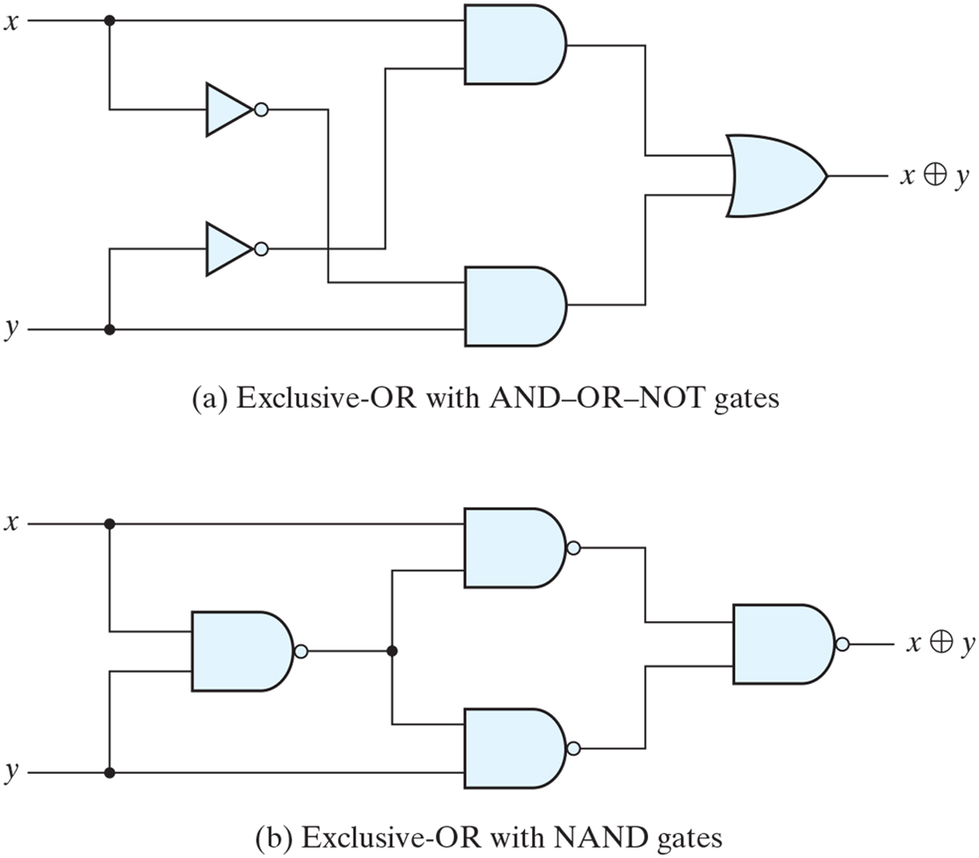
Logic diagrams for exclusive-OR implementations.

Slide 31
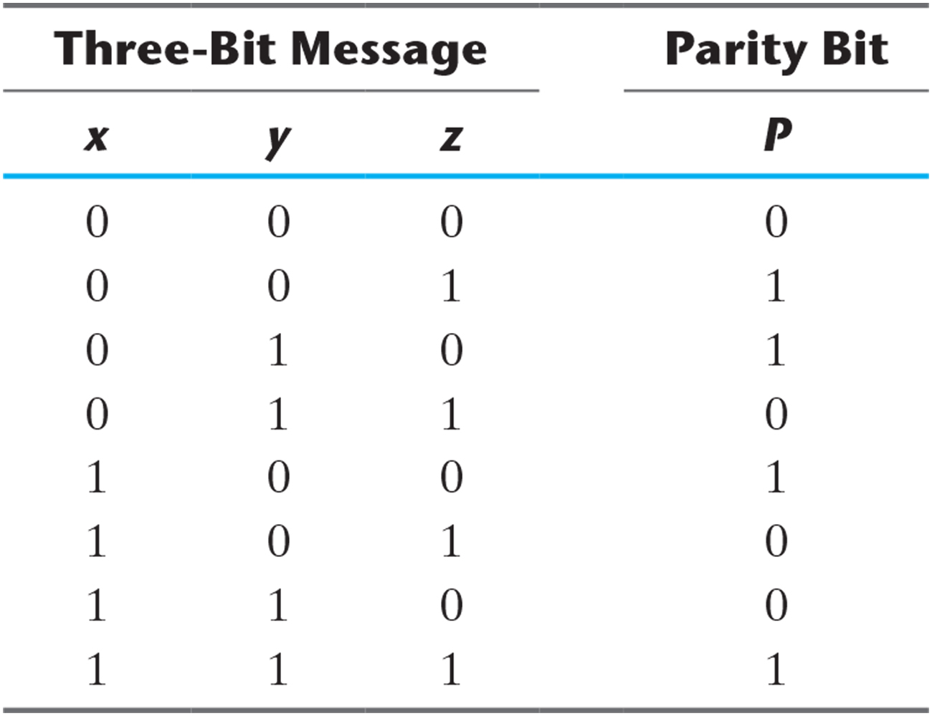
Even-Parity-Generator Truth Table.

Slide 32
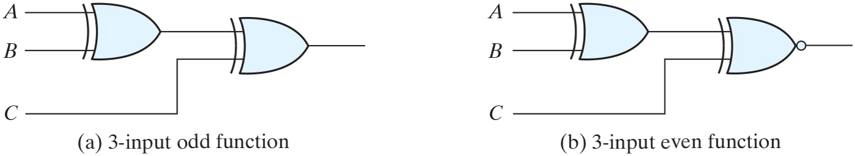
Logic diagram of odd and even functions.

Slide 33
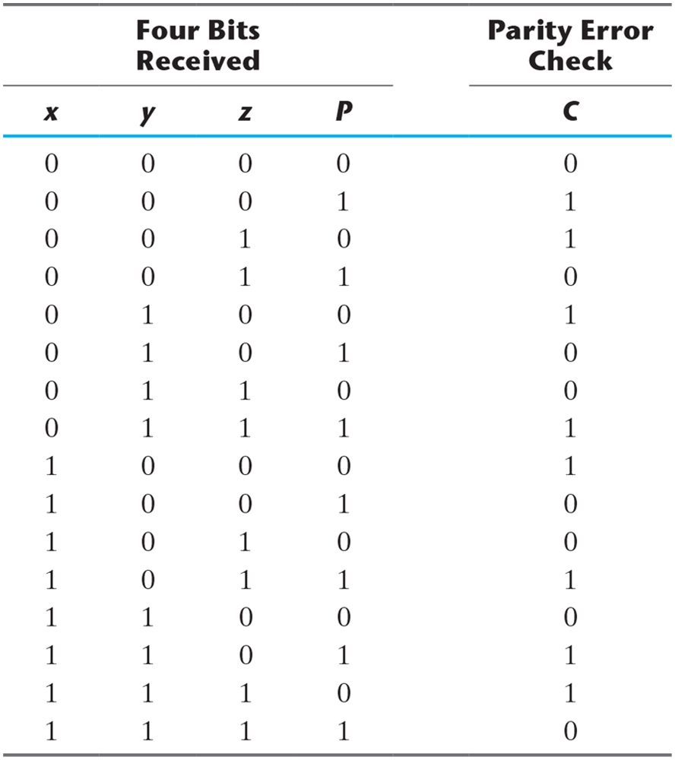
Even-Parity-Checker Truth Table.

Slide 34
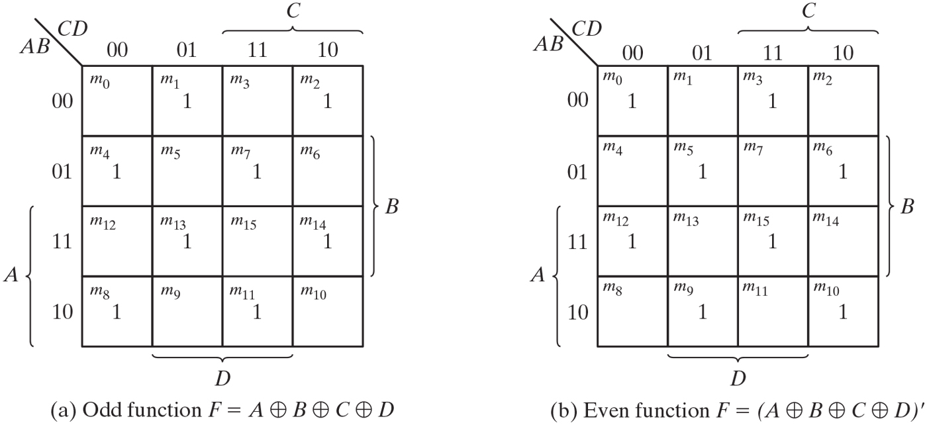
Map for a four-variable exclusive-OR function.

Slide 35
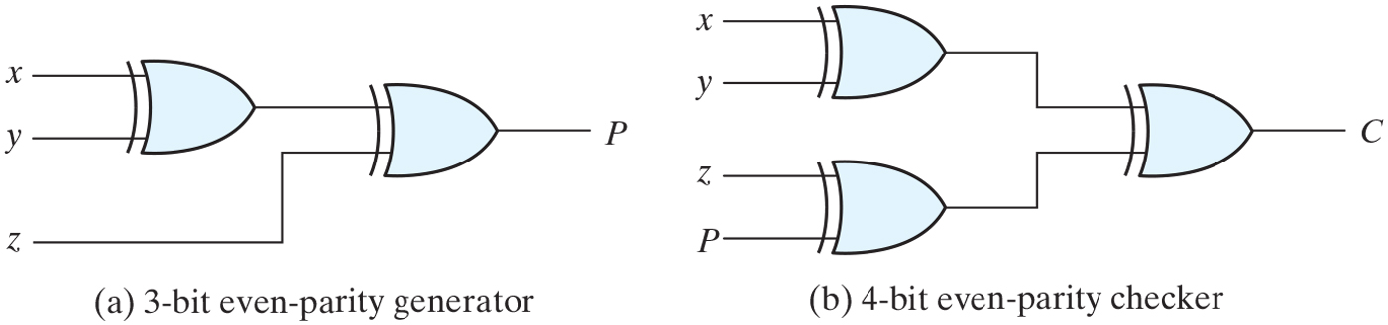
Logic diagram of a parity generator and checker.

Slide 36
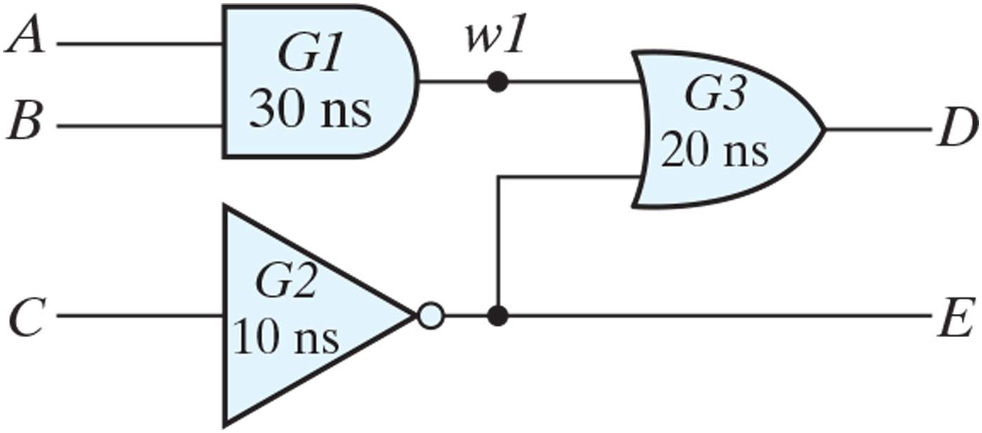
Schematic for and_or_prop_delay.

